Slide 1
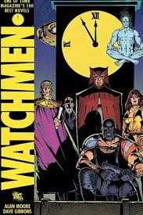
The Watchman by Moore Allan
Character Analysis

Slide 2
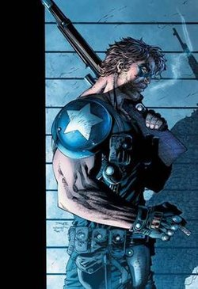
The Comedian
Was one of the two government sanctioned heroes
He remained active after implementation of Keene Act, 1977
Was regarded as a peacemaker (strength)
Had though out insights than others
Notes:
Comedian was among the government sanctioned heroes, and he worked alongside Doctor Manhattan. He stands as among the Heroes in the Watchman novel due to his activeness even after Keen Act was passed, which was meant to ban superheroes. Being a peacemaker is among the strengths of Comedian whereby he could unite those who were involved in disputes, rather than triggering violence. Additionally, Commedia could think more critically as compared to other characters, by giving out insightful thoughts.

Slide 3
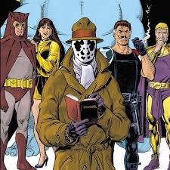
The Comedian continued…
Had a character of Marvel comics spy
Much bigger tougher guy
Being ruthless among (weakness)
Was nihilistic
His character is in line with Gordon Liddy
Notes:
Moore suggested that The Comedian took the character of Spy in the Marvel Comics since he could utilize tactics to investigate cases. Again, the huge body gave him strength to work on critical cases. Green opines that The Comedian was merciless, bringing forth an illustration that he treated victims ruthlessly. Equally, he could discipline the offender according to their offences. Another weakness is that he did not consider victim’s beliefs and religious status, which is among the aspects one should look into when handling criminal cases.

Slide 4
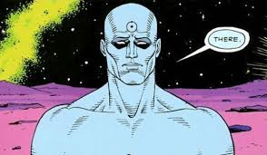
Doctor Manhattan
He was a superpower contracted by the U.S government
Was kind of quantum superhero
His strengths lied in nuclear and quantum physics
Valued human affairs
Notes:
Doctor Manhattan was a hero because he was among the superpowers who were contracted by the U.S government to assist in criminal investigations. According to Moore, Manhattan was among the reliable heroes since he could apply quantum skills to aid in resolving critical cases. Again the writer enlightened that Manhattan strengths was based on his exceptional skills on nuclear and quantum physics, where he was contracted by government to assist in scientific explorations. Moore further suggested that this character valued human affairs much, which is among his weaknesses.

Slide 5
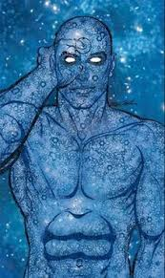
Doctor Manhattan cont…
He wanted to grow away from human beings
He could not see the need of clothing
His character can be associated to that of Captain Atom
He was an emotionless character
Notes:
It is however worth noting that Doctor Manhattan was associated with a number a shortcomings while attending to the assigned duties. It was a disturbing to learn that Manhattan wanted to grow his skills away from other human beings, in quantum universe. Doctor’s second weakness was evidenced in a situation where he did not see the need for clothes (Moore 23). The writer further affirmed that the Doctor was sometimes emotionless, because he did not consider peoples suggestions and feelings. Manhattan character can be associated to Captain Atomic who was a superhero with superhuman strength and atomic absorption.

Slide 6
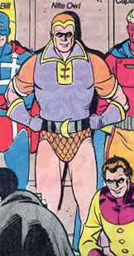
Nite Owl II
A retired superhero who used owl themed gadgets
He was a former crime fighter
Experience and skilled detective
Notes:
Nite Owl II was a retired superhero who used owl themed gadgets. Owl 11 is counted as among the heroes in the Watchman novel because he a former crime fighter. Owl 11 could engage in resolving conflicts both in the streets in addition to working government contracts. Among his vital skills was exceptional skills on detective operations and experience (Moore 45). These skills enabled him to conduct investigations based on the timeframe and guidelines from the government.

Slide 7
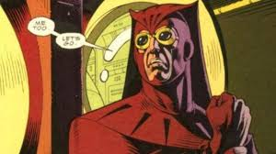
Nite Owl II cont…
He used expensive tools and activities which could not make any difference
He was focused more on his failed past, rather than the future
His character unique character can be associated with Ted Kord.
Notes:
As far as his strengths were concerned, Owl 11 was associated with a number of weaknesses. This character applied expensive tools and activities which could not make any difference (Moore 57). The writer also revealed that Owl 11 focused more on his failed past, rather than the future, a condition which dragged him backwards. His character has the same aspects as those of Ted Kord in Charlton Comics.

Slide 8
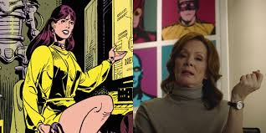
Silk Spectre II
She was among the Charlton Comics, hence being a superhero
She shared the name with mother, and were superheroes in comic book LIimited series
She had physical strength and agility
Notes:
Skill Spectre 11 has been a hero even before the publication of Watchman novel. She was among the significant character in the Comic book Charlton Comics. According to Moore, she shared the mane with mother, and both were features in the comic book, Limited Series. Skill Spectre 11 had physical strength and agility, which is greatest source of power. Spectre 11 was contracted by the government to oversee activities which demanded agility and strength.

Slide 9
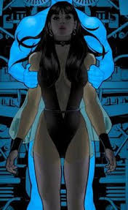
Silk Spectre II
Well versed with firearms
Hand to hand combat
Her weakness is that Moore did not find an exact character in Silk Specter
Her character drawn from heroines such as Black Canary and Phantom Lady
Notes:
Another strength for Skill Spectre 11 was exceptional expertise in firearms. As a result, she could be contracted by the government to take part in crucial undertakings, which involved the use of firearms. Moore confirmed that this character under discussion could apply hand to hand combat, hence being a reliable asset for the government (Green 103). The weakness portrayed in Spectre 11 is that the writer did not find an exact character in Silk Specter (Green 103. Lastly, her unique character can be drawn from other historical heroines such as Black Canary and Phantom Lady.

Slide 10
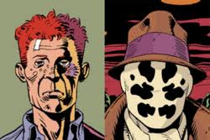
Rorschach
He fought and prevented crime in the street
Was an hero since he did not value heroism, his perspective was different from others
Strengths- hand to hand combat, crafting of improvised weapons and skilled detective work.
Notes:
Rorschach is arguably the most outspoken and main character in the Watchman novel. According to Moore, this character could maintain law and order in the streets by investigating cases and punishing the offenders. Notably, Rorschach did not believe in heroism, and his perspective on leadership was unique (Moore 25). Among the strengths associated with Rorschach can be illustrated as follows; skilled detective work, crafting of improvised weapons and hand to hand combat (Moore 36).

Slide 11
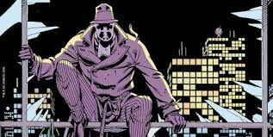
Rorschach
Weakness -he did not see anything good or bad,
Acted violently even when not necessary,
Steve Ditko character can be compared to that of Rorschach
Notes:
In addition to having a unique character, Rorschach did not see anything good or bad. His peers used to complaint due to his behavior because he could act wildly and violently when handling minor cases (Green 104). Moore further conformed that Rorschach acted violently even when not necessary, by causing violence on cases which could have been handled lightly. Ditco character in the historical background can be compared to that of Rorschach.

Slide 12
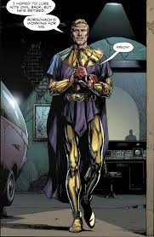
Ozymandias
Hero-considered as the smartest man on the planet
Could catch a bullet, and used his skills non-violently
Strengths-genius level intellect
He was a master in human psychology
Notes:
The writer considered Ozymandias to be the smartest man on the planet. Among the strengths associated with this character is that he could catch a bullet with bare hands. His second strength was associated with general intellect, where he could apply the detective skills to provide informed decisions for the police (Moore 132). Another vital strength evidenced in Ozymandias is the ability to master human psychology (Green 39). The government and the public could seek assistance from him when it comes to reading and analyzing human phycology

Slide 13
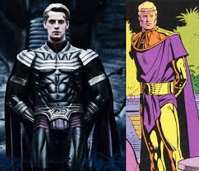
Ozymandias cont….
Strength-he was well versed with Martials arts
Weakness, was politically neutral
Was so friendly that he could not handle crime related issues
His character can be related to thunderbolt and Peter cannon
Notes:
It is important to note that Ozymandias was well versed with Martial Arts where he could utilize them to provide the necessary security for the citizens. One of his major weakness was being political neutral, where he could not support or oppose ideas from government counterparts (Green 126). Again, Ozymandias was so friendly that he could not handle crime related issues because it may result to biasness. His unique character can be related to Peter Cannon

Slide 14
Works Cited
Green, Matthew JA. Alan Moore and the Gothic tradition. Manchester University Press, 2015.
Moore, amp; Dave. “Watchman”. New York: DC Comics, 1987.
Moore, Alicia Hills. "Night watchman. Image# 1." Alicia Hills Moore Photographic Collection, MBL Archives (2015).

